Slide 1
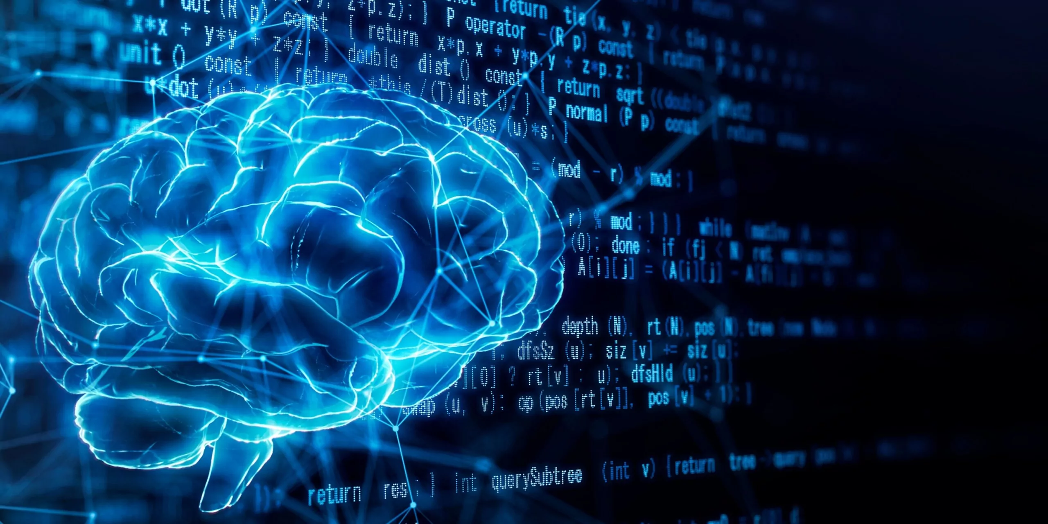
eBPL - Artificial Intelligenc Team - 03 422221104012 GNANAVEL B

Slide 2

Create a Chatbot in Python
Building a chatbot in Python can be a rewarding and exciting project. In this guide, we will go through the steps to create a chatbot from scratch using the Python programming language. Chatbots are widely used in various industries, from customer service to virtual assistants. They provide a convenient way for users to interact with a computer system through text or speech.

Slide 3
A Step-by-Step Guide
Step 1: Plan and Design
Step 2: Gather Requirements
Step 3: Set Up Development Environment
Before diving into coding, it's important to plan and design your chatbot. Define the purpose of your chatbot and the specific tasks it will perform. Consider the target audience and the platform on which the chatbot will be deployed.
Once you have a clear plan, gather all the requirements for your chatbot. This includes defining the conversation flow, identifying the necessary APIs or databases for data retrieval, and deciding on the user interface design.
Before writing code, set up your development environment. Install Python and any necessary libraries or frameworks. Choose an integrated development environment (IDE) that suits your preferences and start a new project.

Slide 4
Designing the Conversation Flow
User Input
Intent Recognition
At the core of any chatbot is its ability to understand and respond to user input. Design a conversation flow that allows the chatbot to handle different types of user queries and provide appropriate responses.
To accurately understand user queries, implement intent recognition. Use natural language processing (NLP) techniques and machine learning algorithms to classify user intents. This will help the chatbot determine the user's goal and provide relevant responses.
Response Generation
Integration with APIs
When formulating responses, keep them informative, concise, and user-friendly. Use pre-defined templates or generate responses dynamically based on the user's query. Make sure the responses are contextually relevant and provide value to the user.
If your chatbot requires data from external sources, integrate relevant APIs into your chatbot. This could include retrieving weather information, querying a database, or connecting to third-party services.

Slide 5

Improving User Experience
1
Personalize Conversations
Add a personal touch to your chatbot by customizing responses based on user preferences. Use data such as user history, location, and preferences to make the chatbot's interactions more relevant and engaging.
2
Error Handling
Handle errors gracefully by providing clear error messages and suggestions for the user. Anticipate common errors and guide the user towards resolving them. This will help improve the overall user experience and reduce frustration.
3
User Feedback
Collect user feedback to continuously improve your chatbot. Implement a feedback mechanism that allows users to provide suggestions, report issues, or rate the chatbot's performance. Regularly analyze and consider user feedback for future enhancements.

Slide 6
Challenges and Solutions
Challenge: Natural Language Understanding
Challenge: Scalability
Solution: Continuous Training
As your chatbot gains popularity, it's essential to ensure its scalability. Design your chatbot to handle increased user traffic without compromising performance. Utilize cloud-based infrastructure and load balancing techniques to meet scalability requirements.
Regularly update and retrain your chatbot to improve its performance. Use user feedback, conversations, and data analytics to identify areas for improvement. Continuously fine-tune the chatbot's algorithms and models to enhance its accuracy and effectiveness.
One of the main challenges in chatbot development is accurately understanding and interpreting user queries. Implementing robust natural language understanding (NLU) models and leveraging machine learning algorithms can help overcome this challenge.

Slide 7

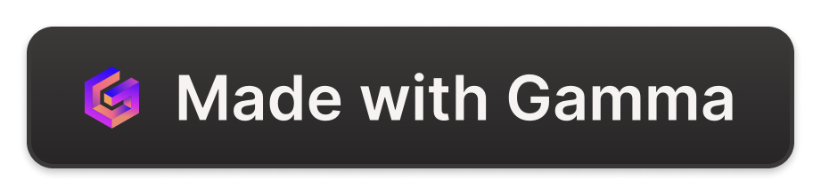
Use Cases of Chatbots
Chatbots have a wide range of applications across various industries:
Customer Support: Chatbots can provide instant support and answer common customer queries, freeing up human agents for more complex issues.
E-commerce: Chatbots can help users browse products, provide recommendations, and assist with the purchasing process.
Virtual Assistants: Chatbots can act as personal assistants, helping users manage their schedules, set reminders, and perform tasks.
Information Retrieval: Chatbots can retrieve information from databases or external APIs, providing users with real-time data.
These are just a few examples of how chatbots are revolutionizing various industries and improving user experiences.

Slide 8
Conclusion
Creating a chatbot in Python is an exciting and challenging endeavor. By following this guide and leveraging the power of Python, you can develop intelligent chatbots that enhance user experiences and automate various tasks. Remember to continuously improve your chatbot based on user feedback and evolving requirements. Get started today and unlock the potential of chatbot technology!

